Slide 1
Week 3 Stack Data Structure
Tri A. Budiono
COMP6571 Data Structures and Algorithms
Even Semester 2020/2021

Slide 2
Outline
Review Week 2
Feedback for Week 2 Lab works
Lab instruction for Lab Week 3
Illustrations for Stack and its applications

Slide 3
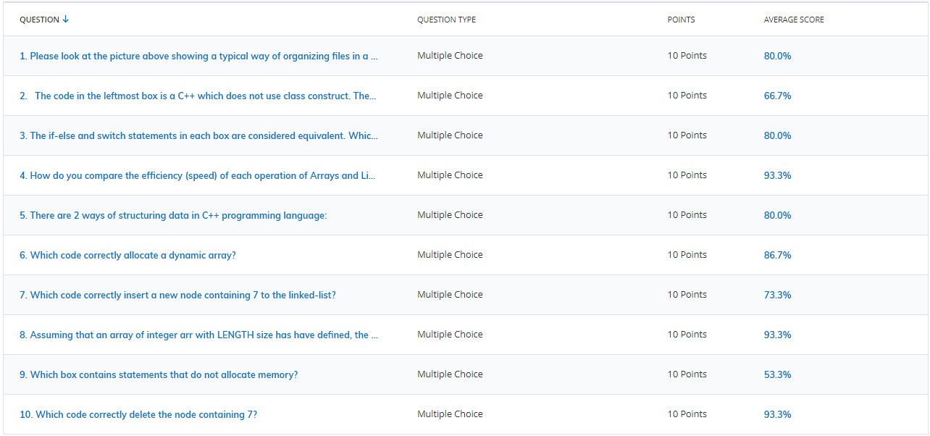
Review Quiz 1
Class
if-else, switch
Memory Allocation
Insertion and Deletion in Linked-list
File organizations

Slide 4
3 Class vs no class
const int LEN = 10;
int arr[10];
int idx = 0;
bool insert(int item){
bool success = true;
if(idx < LEN){
arr[idx] = item;
idx++;
}else
success = false;
return success;
}
void print(){
for(int i = 0; i<idx; i++){
cout << arr[i] << " ";
}
}
class ArrayADT
{
private:
const int LEN = 10;
int* arr;
int idx;
public:
ArrayADT();
~ArrayADT();
bool insert(int item);
void print();
};
ArrayADT::ArrayADT(){
arr = new int[LEN];
idx = 0;
}
ArrayADT::~ArrayADT(){
delete(arr);
}
bool ArrayADT::insert(int item){
bool success = true;
if(idx < LEN){
arr[idx] = item;
idx++;
}else
success = false;
return success;
}
void ArrayADT::print(){
for(int i = 0; i<idx; i++){
cout << arr[i] << " ";
}
}
class ArrayADT
{
private:
const int LEN = 10;
int arr[10];
int idx = 0;
public:
bool insert(int item){
bool success = true;
if(idx < LEN){
arr[idx] = item;
idx++;
}else
success = false;
return success;
}
void print(){
for(int i = 0; i<idx; i++){
cout << arr[i] << " ";
}
}
};
class ArrayADT
{
private:
const int LEN = 10;
int arr[10];
int idx = 0;
public:
bool insert(int item);{
void print();
};
bool ArrayADT::insert(int item){
bool success = true;
if(idx < LEN){
arr[idx] = item;
idx++;
}else
success = false;
return success;
}
void ArrayADT::print(){
for(int i = 0; i<idx; i++){
cout << arr[i] << " ";
}
}
class ArrayADT
{
private:
const int LEN = 10;
int* arr;
int idx;
public:
ArrayADT(){
arr = new int[LEN];
idx = 0;
}
~ArrayADT(){
delete(arr);
}
bool insert(int item){
bool success = true;
if(idx < LEN){
arr[idx] = item;
idx++;
}else
success = false;
return success;
}
void print(){
for(int i = 0; i<idx; i++){
cout << arr[i] << " ";
}
}
};
(D)
(A)
(B)
(C)
The code in the leftmost box is a C++ which does not use class construct. The code in all other boxes convert the leftmost box into a C++ class. Assuming each box has correct include and namespace statements, please, figure out which box is correct?
A, B, C and D
A, B and C
A and B
C and D

Slide 5
1 Selection: If-else vs switch
int option;
switch(option){
case 1: doX(); break;
case 2: doY(); break;
case 3: doZ(); break;
default: doWrong(); break;
}
if(option == 1)
doX(); break;
else if (option == 2)
doY(); break;
else if(option == 3)
doZ(); break;
else
doWrong(); break;
}
int option;
switch(option){
case 1: doX(); break;
case 2: doY(); break;
case 3: doZ(); break;
default: doWrong(); break;
}
if(option == 1)
doX();
else if (option == 2)
doY();
else if(option == 3)
doZ();
else
doWrong();
}
string option;
switch(option){
case "option1": doX(); break;
case "option2": doY(); break;
case "option3": doZ(); break;
default: doWrong(); break;
}
if(option == "option1")
doX();
else if (option == "option2")
doY();
else if(option == "option3")
doZ();
else
doWrong();
}
char option;
switch(option){
case 'X': doX(); break;
case 'Y': doY(); break;
case 'Z': doZ(); break;
default: doWrong(); break;
}
if(option == 'X')
doX();
else if (option == 'Y')
doY();
else if(option == 'Z')
doZ();
else
doWrong();
}
(A)
(B)
(C)
(D)
The if-else and switch statements in each box are considered equivalent. Which box are are correct?
A, B, C and D
A and B
C and D
B and D

Slide 6
7 Struct
typedef struct node {
int data;
struct node* link;
} NODE;
struct node {
int data;
struct node* link;
} NODE;
struct node {
int data;
struct node* link;
} * NODE;
struct node {
int data;
struct node* link;
} NODE[10];
(A)
(B)
(C)
(D)
Which box contains statements that do not allocate memory?
A and C
B and D
A and B
C and D

Slide 7
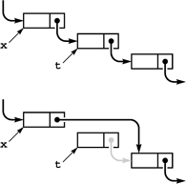
9 Linked-list: Delete
5
7
9
5
7
9
t = x->next;
x->next = t->next;
delete t;
x->next = x->next->next;
delete t;
t->next = t->next->next;
delete t;
delete t;
(A)
(B)
(C)
(D)
Which code correctly delete the node containing 7?
A, B, C and D
A and B
B and C
C and D

Slide 8
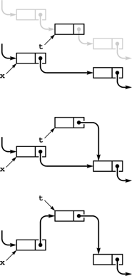
10 Linked-list: Insert
7
5
t = x->next;
x->next = t
t->next = x->next;
x->next = t;
9
(A)
(B)
t->next = x->next;
x->next = t->next;
x->next = t;
t->next = x->next;
7
(C)
(D)
5
9
Which code correctly insert a new node containing 7?
A and B
C and D
B only
C only
7
5
9

Slide 9
4 Separating Interface from Implementation
X.h
X.cpp
Y.cpp
#include “X.h”
#include “X.h”
int main(){
}
(A)
(B)
(C)
Which of the following statement is correct?
X.h is the interface, X.cpp is the implementation, Y.cpp is the client
X.h is the implementation, X.cpp is the interface, Y.cpp is the client
X.h is the interface, X.cpp is the client, Y.cpp is the implementation
X.h is the client, X.cpp is the implementation, Y.cpp is the interface

Slide 10
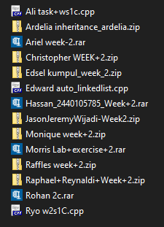
Feedback for Week 2 Lab Work
Please, name your submitted file with you name

Slide 11
How Lab Grade will be counted?
Lab Problem Set : 80%
Weekly Quiz : 20%
No | Week | Topic | Problem Set (80%) | Quiz (20%) | Score
1 | 2 | List | 80 | 100 | 84
2 | 3 | Stack | 85 | 100 | 88
3 | 4 | Queue | 90 | 80 | 88
4 | 5 | Tree | 100 | 90 | 98
5 | 6 | Set | 100 | 60 | 92
6 | 7 | Advanced Set | 90 | 70 | 86
7 | 8 | Graph | 80 | 100 | 84
8 | 9 | Digraph | 75 | 100 | 80
9 | 10 | Searching and Sorting | 100 | 70 | 94
10 | 11 | Algorithm analysis | 70 | 90 | 74
FINAL SCORE |  |  |  |  | 87

Slide 12
Will late submissions be counted?
Yes, with certain penalty which is 10% per week late
What about re-submission or revision?
Re-submitted lab work or revision is considered late if it’s submitted more than one week after the first due date
It means, Lab scores can change to better one throughout the semester
10% for a late submission of Lab w1
0% for a revision of Lab w1
20% for a late submission of Lab w1
10% for a late revision of Lab w1
w1
w2
w3
w11
w12
Wed

Slide 13
Review Lab Work Week 2
How to declare struct
How to define struct variables
How to use const keyword
etc. questions from you…

Slide 14



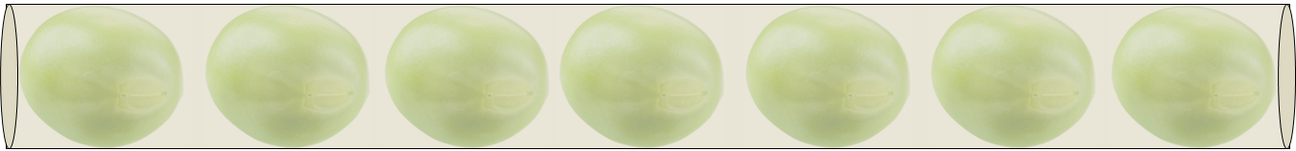
Linear Data Stuctures
Four kinds of linearly ordered abstract data types (ADT):
List
Stack
Queue
Deque

Slide 15




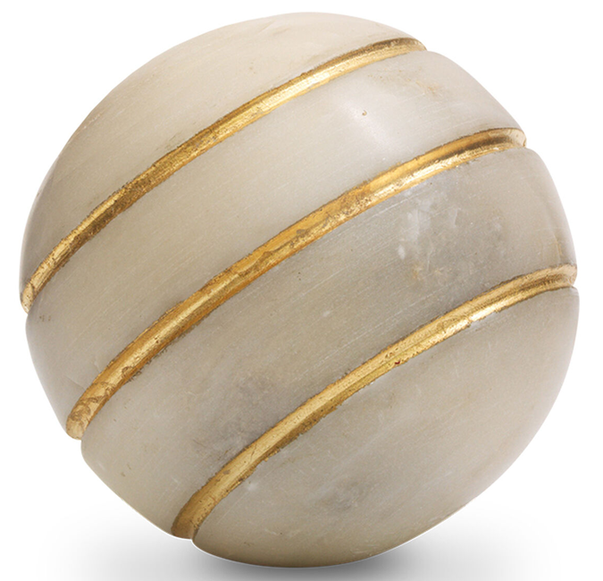



Bag of marbles
no order
Tree of marbles
hierarchically ordered
List of marbles
linearly ordered

Slide 16
QUESTION TO PONDER:
What’s the difference between
ORDERING and SORTING
in the study of Data Structures and Algorithms?

Slide 17
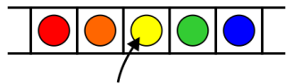
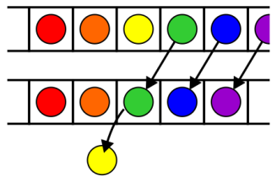
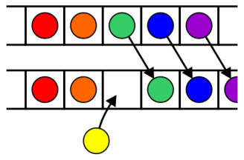
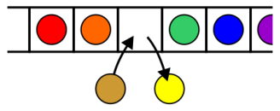
List
List allows insertion and deletion of item at arbitrary position
Access to the object
Erasing an object
Insertion of a new object
Replacement of the object

Slide 18
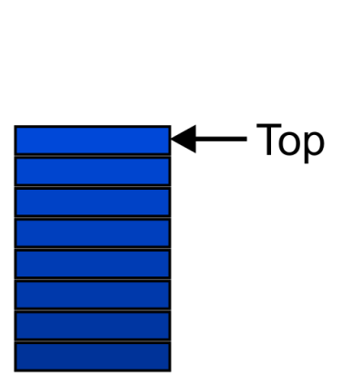
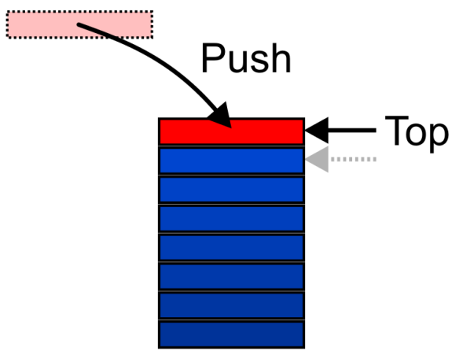
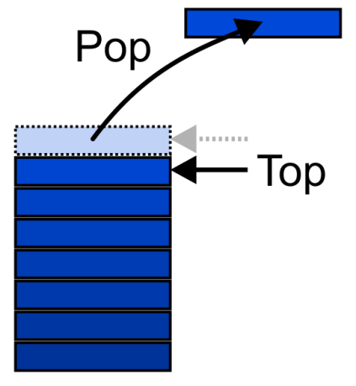
Stack
Stack is a last-in–first-out (LIFO) data structure

Slide 19
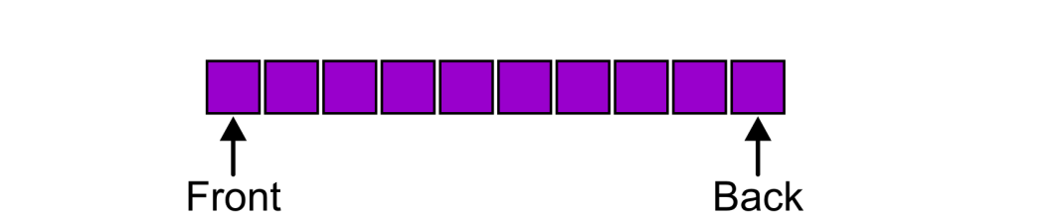
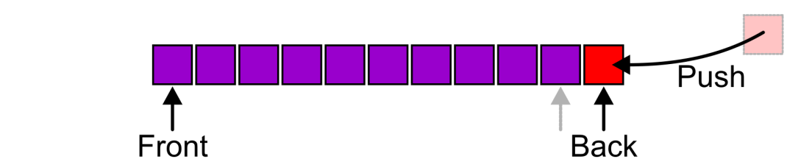
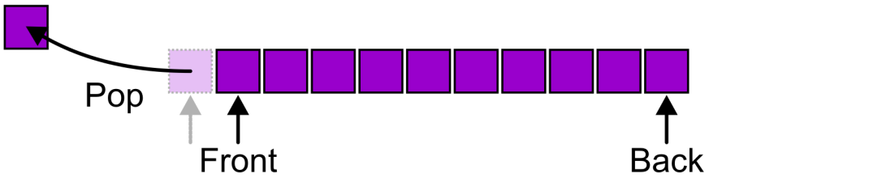
Queue
Queue is a first-in–first-out (FIFO) data structure

Slide 20
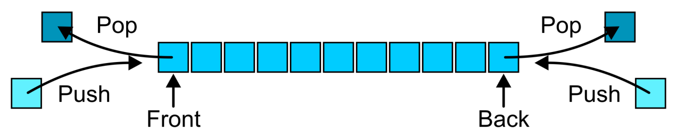
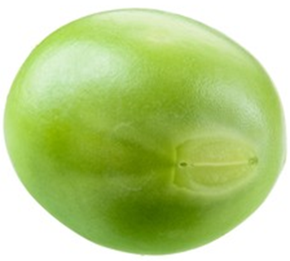
Deque
Deque allows insertions at both the front and back of the deque

Slide 21
Comparing Linear Data Structures
Position of item | List |  | Stack |  | Queue |  | Deque
posisi item | insert | delete | insert | delete | insert | delete | insert | delete
beginning (front or top) | v | v | v | v | x | v | v | v
end (rear) | v | v | x | x | v | x | v | v
arbitrary (in between) | v | v | x | x | x | x | x | x

Slide 22
Today agenda is Stack
Array Implementation of Stack
Linked Implementation of Stack
Stack Application

Slide 23
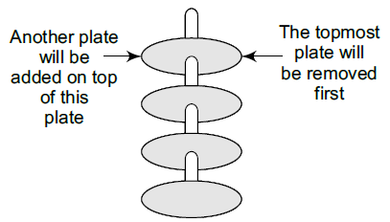
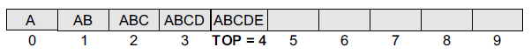
Array Implementation of Stack
class Stack
{
private:
int st[MAX];
int top=-1;
public:
void push(int item);
int pop();
int peek();
void display();
};
MAX
top = -1; // empty stack

Slide 24
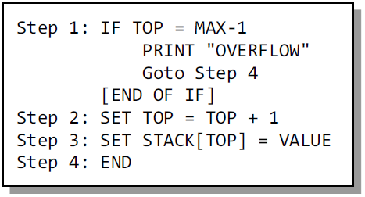
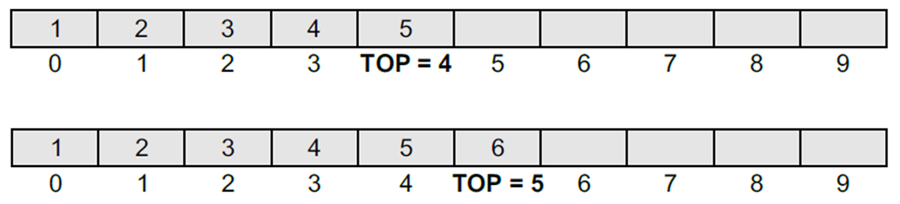
Push Operation

Slide 25
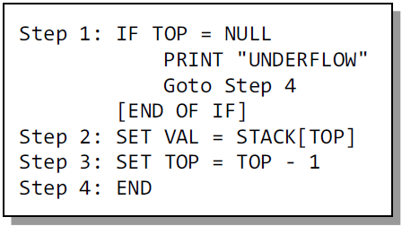
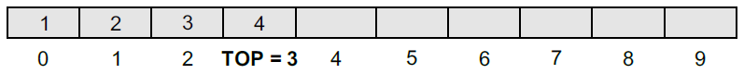
Pop Operation

Slide 26
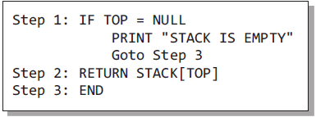
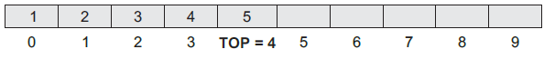
Peek Operation

Slide 27
Practice
SESSION 1
Tutorial w3s1a: Array-based Stack
Tutorial w3s1b: Stack Application
Tutorial w3s1c: Linked-based Stack (optional)
SESSION 2
Tutorial w3s2a: Function Template
Tutorial w3s2b: Class Template
Tutorial w3s2c: Template for Stack

Slide 28
Mandatory submission
Tutorial w3s1b: Stack Application
Tutorial w3s2c: Template for Stack

